Slide 1
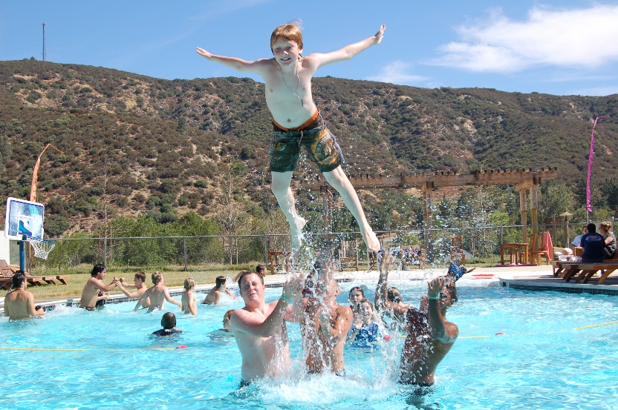
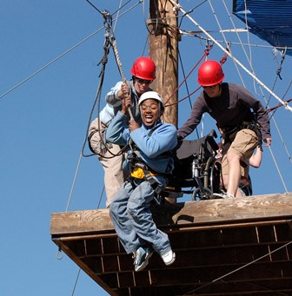
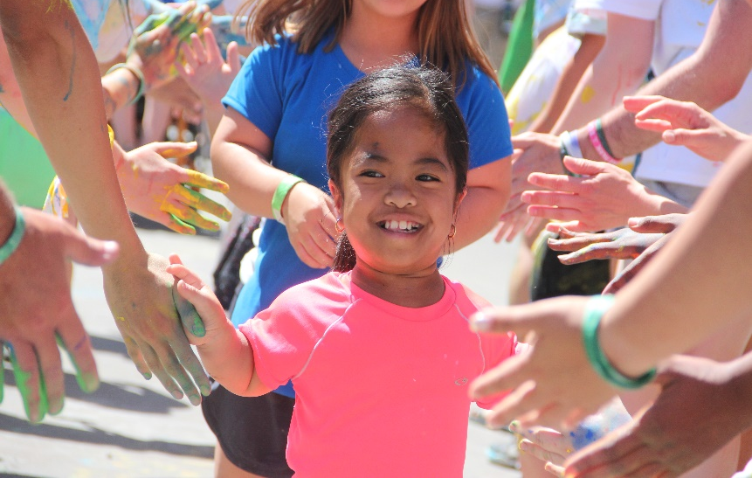

Slide 2
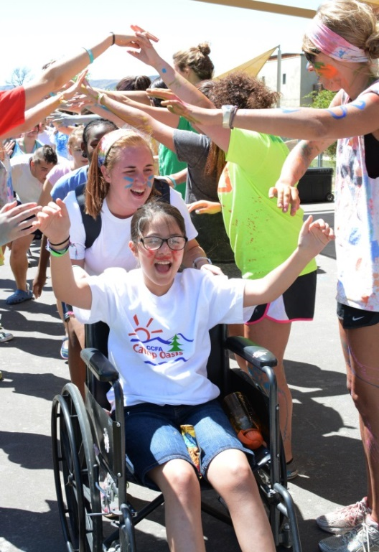
What is The Painted Turtle?
Mission
The Painted Turtle’s mission is to provide a year-round, life-changing environment and authentic camp experience for children ages 6-17 with chronic and life-threatening illnesses. The Painted Turtle supports children’s medical needs, inspires them to reach beyond their illnesses, and provides care, education, and respite for their families.

Slide 3
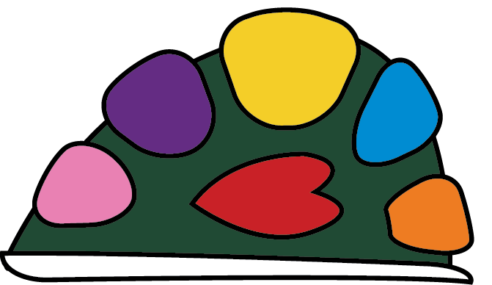
Core Values
Community Work as a community
to create impactful change.
Trust Build trust by acting with
integrity, reliability, and
mutual respect.
Heart Operate with intention
from the heart.
Courage Embody courage:
be bold, be creative,
be our best selves!
Vision Strive towards a
greater vision by
pursuing growth,
exhibiting leadership,
and embracing the power
of new ideas.
Compassion Serve with compassion to
foster a supportive and
inclusive environment.
Joy Choose Joy.

Slide 4
History
The Painted Turtle began as a dream in 1999 when Paul Newman and Page Adler, along with a group of other dedicated individuals, co-founded The Painted Turtle to let kids with medical conditions just be kids. Through the ongoing commitment of these individuals, many of whom sit on our board today, the dream of The Painted Turtle became a reality.

Slide 5
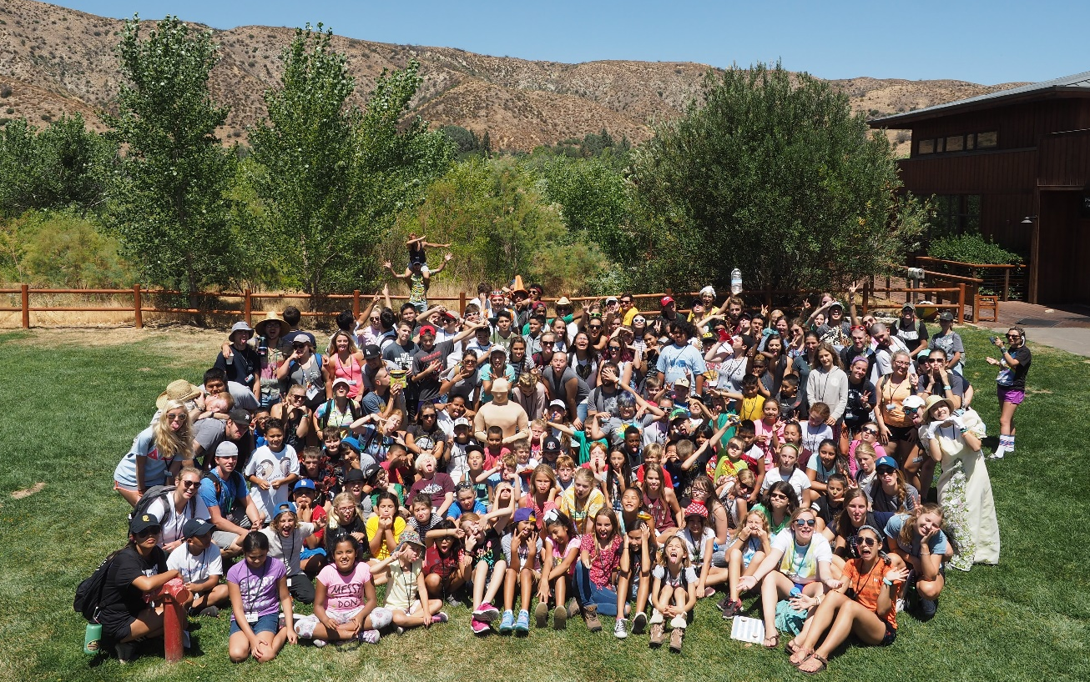
What is The Painted Turtle?
Located in Lake Hughes, California, The Painted Turtle has served over 138,000 children and their families since opening in 2004.
All campers and families attend free of charge!

Slide 6
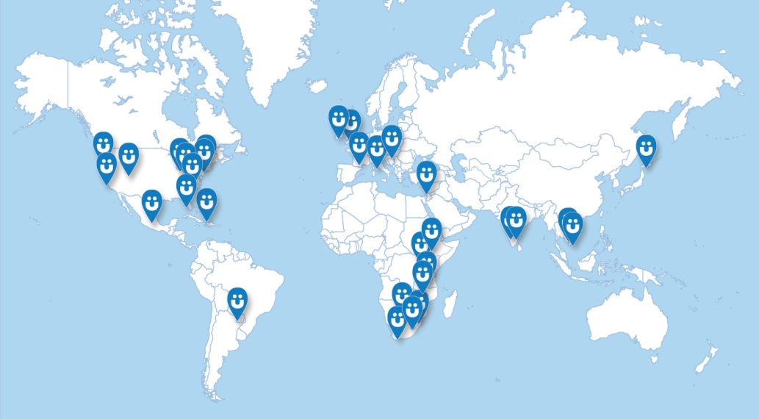
What is The Painted Turtle?
The Painted Turtle is proud to be part of the SeriousFun Children’s Network, a global community of 30 camps and programs designed to empower children to see beyond their medical conditions.
Beginning with the first camp founded by Paul Newman in 1988, SeriousFun has now delivered more than one million camp experiences to children and family members from over 50 countries. Each camp is an independent nonprofit organization made possible by generous donations to serve all children at no cost to their families.
Notes:
NORTH AMERICA:
CALIFORNIA ∙ The Painted Turtle
COLORADO ∙ Roundup River Ranch
CONNECTICUT ∙ The Hole in the Wall Gang Camp
FLORIDA ∙ Camp Boggy Creek
MICHIGAN ∙ North Star Reach
NEW YORK ∙ Double H Ranch
NORTH CAROLINA ∙ Victory Junction
OHIO ∙ Flying Horse Farms
WASHINGTON ∙ Camp Korey
MIDDLE EAST: ISRAEL ∙ Jordan River Village
EUROPE:
FRANCE ∙ L’Envol
HUNGARY ∙ Bátor Tábor IRELAND ∙ Barretstown
ITALY ∙ Dynamo Camp
UNITED KINGDOM ∙ Over The Wall
CARIBBEAN:
HAITI ∙ Kan Etwal - Camp of Stars (GPP)
AFRICA:
BOTSWANA ∙ Camp Hope (GPP)
ETHIOPIA ∙ Camp Addis (GPP)
LESOTHO ∙ Camp ‘Mamohato (GPP)
MALAWI ∙ Camp Hope (GPP)
SOUTH AFRICA ∙ Just Footprints*
SWAZILAND ∙ Sivivane Camp (GPP)
UGANDA ∙ Sanyuka Camp (GPP)
TANZANIA ∙ Salama Camp (GPP)
ASIA:
CAMBODIA ∙ Camp Lotus (GPP) INDIA ∙ Camp Rainbow - Bangalore (GPP)
INDIA ∙ Camp Rainbow - Chennai (GPP)
JAPAN ∙ Solaputi Kids’ Camp*
VIETNAM ∙ Camp Colors of Love (GPP)
(GPP) Global Partnership Program

Slide 7
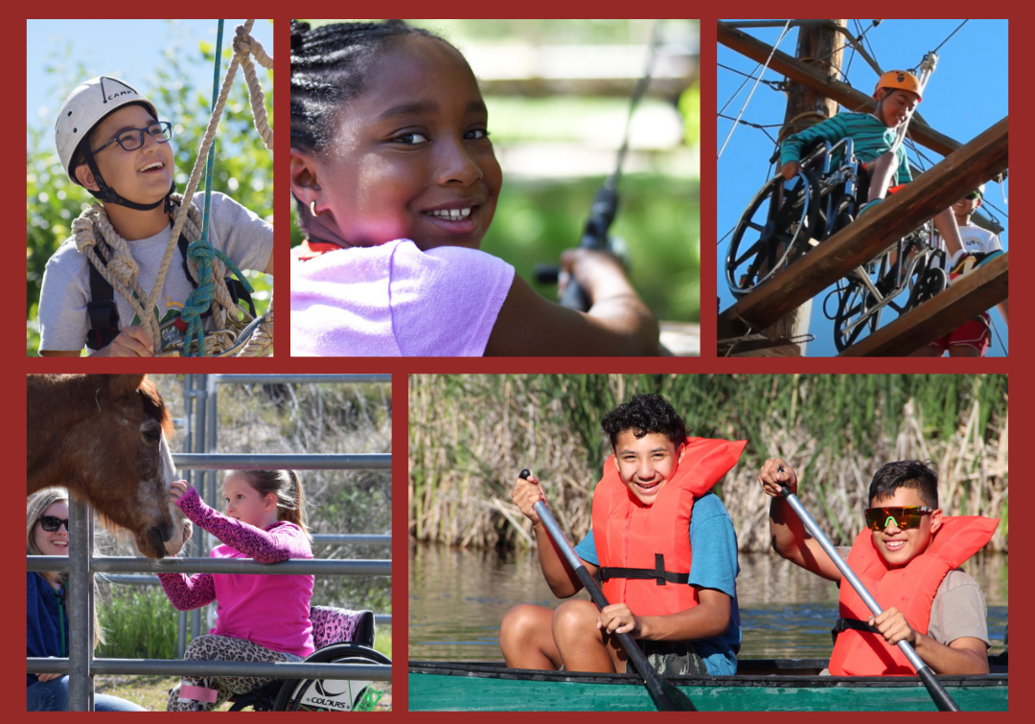
Conditions Served
Over 120+ Medical Conditions Served!
Cerebral Palsy
Cystic Fibrosis
Chrohn’s Disease & Ulcerative Colitis
Hemophilia/Von Willebrand
Disease/with Inhibitors
Kidney & Liver Disease
Solid Organ Transplants
Muscular Dystrophy
Spina Bifida
Skeletal Dysplasia (Dwarfism)
For a full list of medical conditions click the link below:
Medical Criteria - The Painted Turtle

Slide 8
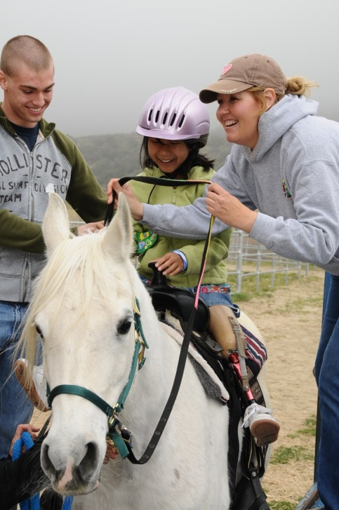
Programs
Family Weekends: Throughout the spring, winter, and fall, The Painted Turtle invites families who are living with the challenges of a medical condition to experience a weekend at camp.
Summer Sessions: Each summer, The Painted Turtle welcomes children ages 7 to 16 for our week-long sessions.
Camp at Home Camp programming available from the comfort of home via Zoom!
Hospital Outreach Program: Sending activity bags & holding virtual visits with partner hospitals.
Notes:
Hospital Outreach Program visits 22 hospitals throughout California
Last year in 2021, we continued with virtual programs. We were able to add in-person limited days in the summer at Camp and a Camp on the Move: Parking Lot Party and Home Edition program throughout California. Our programs continue to be well received and families are eager to return to Camp. Between our virtual, onsite, and hospital program, we served just over 29,500 children and family members in 2021.

Slide 9
The Campsite
173 acres, Located in Lake Hughes, California

Slide 10
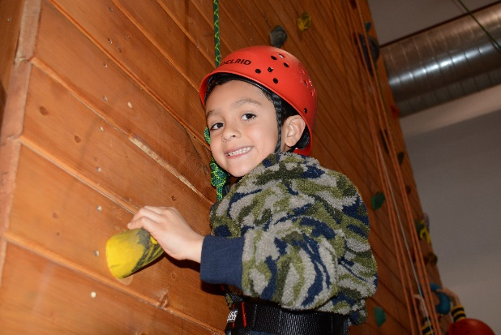
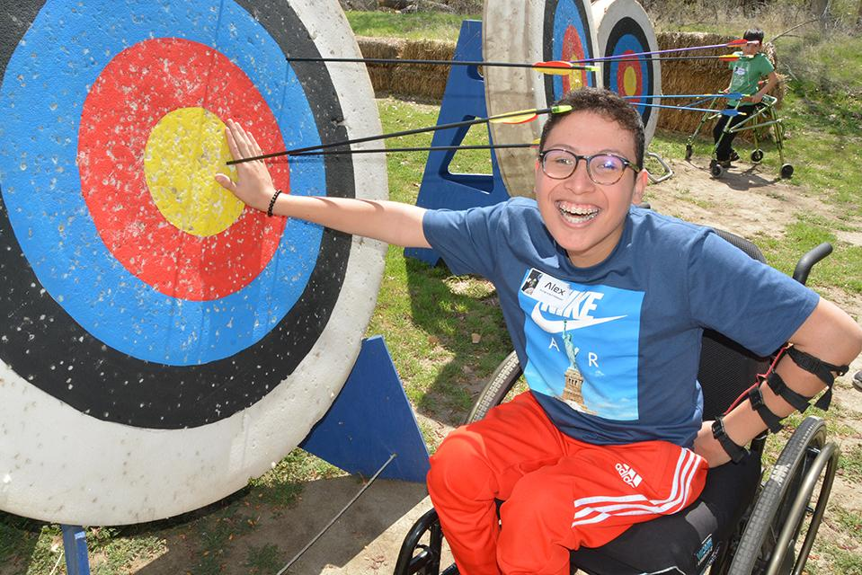
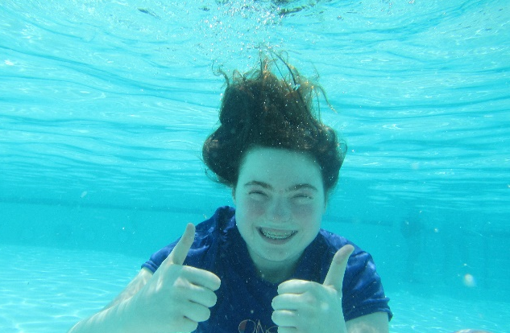
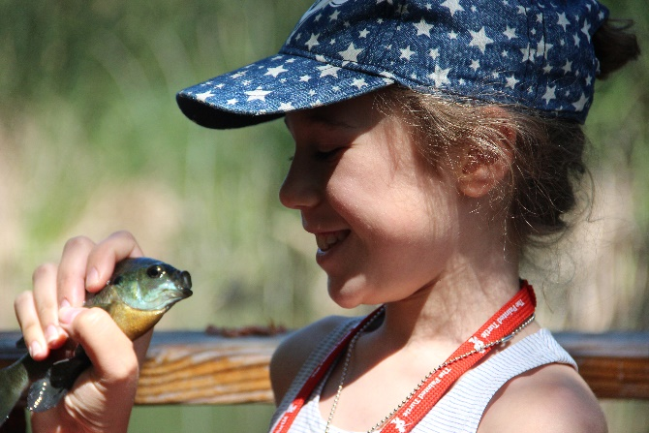
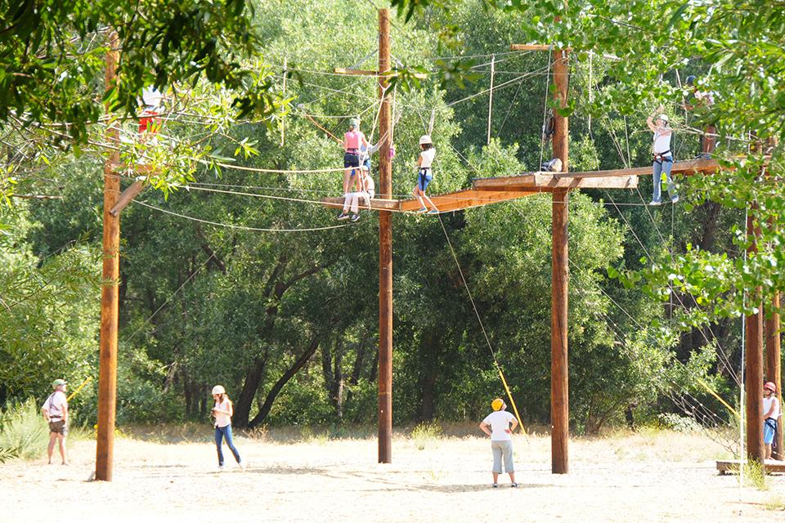
Activities at Camp
Gym, Fishing, Art & Crafts
Swimming, Woodshop
Archery,
Ropes Course
Horseback Riding, Boating,
& More!
All program areas are adaptable!
Notes:
Add photos of kids

Slide 11
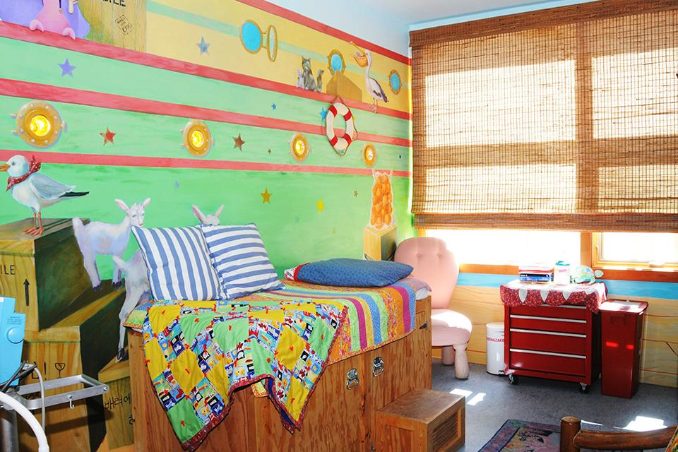
The Well Shell
A 6,000 square foot, state of the art medical facility that includes 4 treatment rooms, 2 overnight rooms, and a pharmacy!
Staffed by Physicians, Nurses, NPs, and PAs to provide care to the campers and families

Slide 12
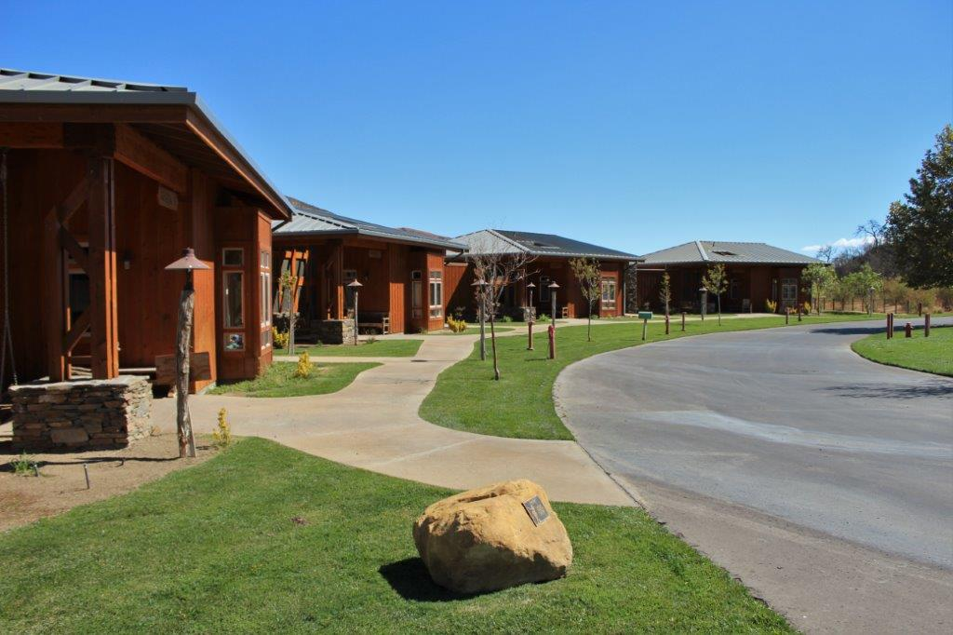
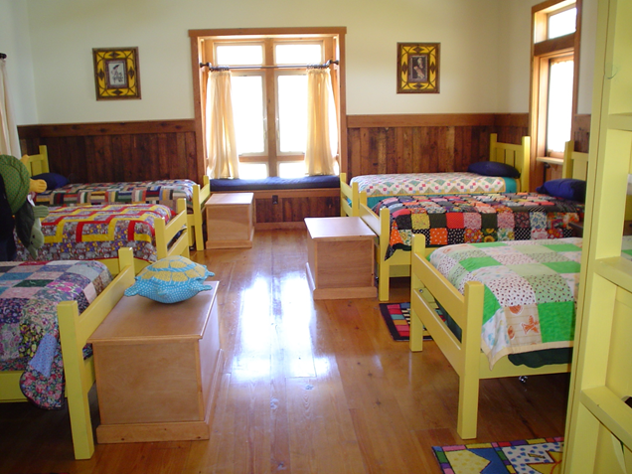
Life at Camp
Camper/Family Housing- 4 Bales: 16 Total Cabins
Family Weekends:
up to 12-15 families
Summers:
up to 50-60 campers
Staff Housing

Slide 13
Why Kids Need Camp
Improved confidence and higher self-esteem
Greater sense of independence
Increased interest in social activities
Decrease in illness related stress
and psychological difficulties
Improved relationship skills
(Outcomes study by The Child Study Center at Yale University School of Medicine, 2014)

Slide 14
Why You Need Camp
Be part of an internationally recognized nonprofit who all share the mission to serve children with serious medical conditions.
Work in a supportive team setting, with a diverse group of individuals who want to make a difference.
Learn to plan, adapt, & implement intentional programs for campers with various medical needs.
Help children reclaim their childhood while creating memories they will carry with them for a lifetime.
Your life will be touched forever by the children we serve
and the people you work alongside.

Slide 15
Paid Summer Positions
Paid Positions:
Cabin Life
Programming
Leadership
Medical positions available for medical professionals licensed in California.
Details:
Must be 19+ to apply
Paid Bi-weekly, Salary Range: $3500-$5000
Most positions start in mid to late May. Waterfront, Entertainment, Adventure, and Leadership positions start earliest to allow for training.
All positions are required to live on camp. Housing in air-conditioned cabins
Meals provided while camp is in session.

Slide 16
A Day in the Life
7:30a Sunrise Activity: Archery, Boating, or Yoga
8:30 Breakfast
9:30 Cabin Clean Up
10-12 Activities
12:30p Lunch
1:30 Chill Time - Cabins
3-5 Activities
5:15 Turtle Time
6:00 Dinner
7:15 Evening Activity: Campfire, Stage Night, Carnival, etc…
8:30 Lights Out Younger Campers
10:00 Lights Out Older Campers

Slide 17
Staff Life
How Many Sessions?
Seven, 5–6-day Summer Sessions
One, 3-day Family Weekend
Time Off?
Each day: an hour off
In-between sessions: 2-3 days off

Slide 18
Volunteer
Can’t join us for the whole summer? Volunteer for a week during the summer or weekend in Fall or Spring!
Summer Weeklong Volunteers
Ages 19+
Cabin Counselor Role
Paired with Summer Staff
One day Orientation
Fall & Spring Weekend Volunteers
Ages 19+
Two Roles
Host a family as a Family Pal
Run and activity area as an Activity Pal

Slide 19
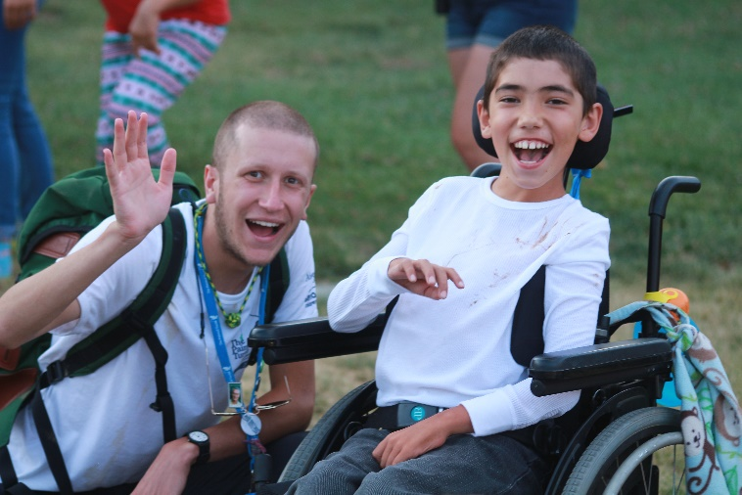
What others say about working at Camp?
“My experience at The Painted Turtle is something that will remain with me for the rest of my life. Camp is like no other place in the world; I have never been surrounded by a group of people who work together so cohesively and selflessly towards an incredible goal.
Reflecting on my time spent at The Painted Turtle makes me realize what a truly precious gift camp is, for both campers and counselors. Spending the summer here is one of the greatest opportunities life has offered thus far.” – Cabin Counselor

Slide 20
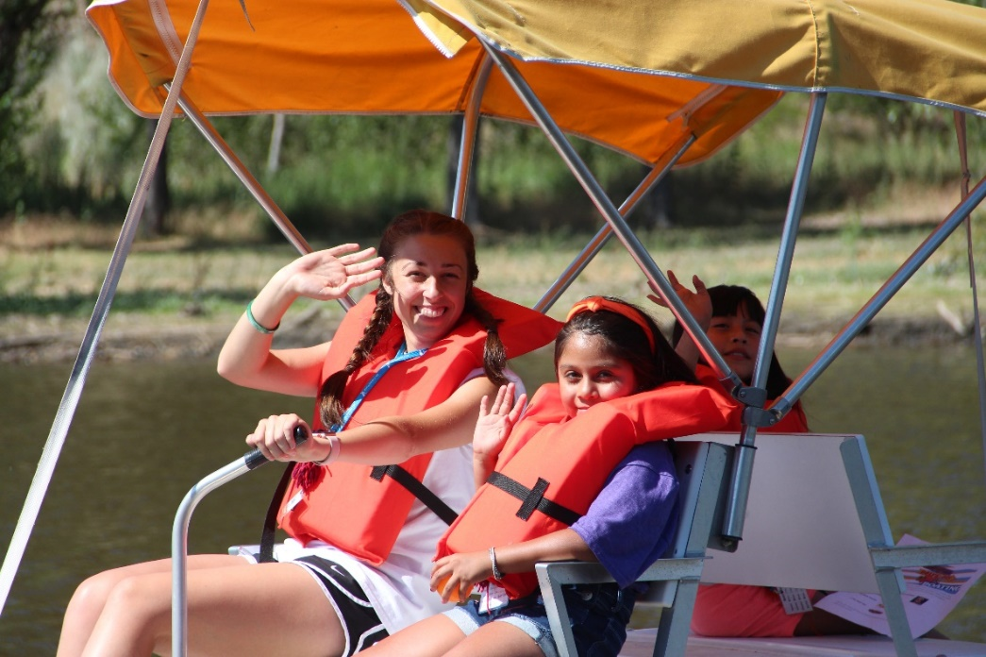
Put a Little Camp in your this summer!
Summer Staff Questions: Tim Deisler, Camp Director | timd@thepaintedturtle.org
Volunteer Questions: Megan O’Meara, Volunteer Manager | volunteer@thepaintedturtle.org
www.thepaintedturtle.org

